Slide 1
Apriori Algorithm
Made by Leyan

Slide 2
Outline
DataSet
Apriori
Apriori (Hash Tree)
FP-Growth
Conclusion & observation
WEKA

Slide 3
DataSet
Kaggle : https://www.kaggle.com/xvivancos/transactions-from-a-bakery/home
DataName : Transactions from a bakery
Column : {Date , Time , Transaction , Item}
Column Date. (YYYY-MM-DD format). From 30/10/2016 to 09/04/2017.
Time. (HH:MM:SS format).
Transaction. The rows that share the same value in this field belong to the same transaction.
Item. Categorical variable with the products
ItemSet : 9683 rows

Slide 4
DataSet
DataName : IBM
Generate : "IBM Quest Data Generator.exe" lit -ntrans 1 -tlen 5 -nitems 50 -npats 500 -patlen 3
Column : {Number , TID , Item}
Number of transactions in database = 1000
Average transaction length = 5
Number of items = 50000
Large Itemsets:
Number of patterns = 500
Average length of pattern = 3
Correlation between consecutive patterns = 0.25
Average confidence in a rule = 0.75
Variation in the confidence = 0.1
ItemSet : 921 rows

Slide 5
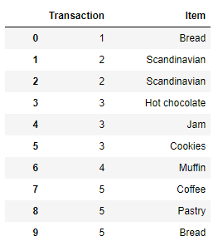
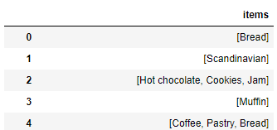
DataSet
Data Preprocessing

Slide 6
DataSet
DataName : IBM
Column : {TID , Transaction , Item}
Number of transactions in database = 1000
Average transaction length = 5
Number of items = 50000
Large Itemsets:
Number of patterns = 500
Average length of pattern = 3
Correlation between consecutive patterns = 0.25
Average confidence in a rule = 0.75
Variation in the confidence = 0.1
Notes:
"IBM Quest Data Generator.exe" lit -ntrans 1 -tlen 5 -nitems 50 -npats 500 -patlen 3

Slide 7
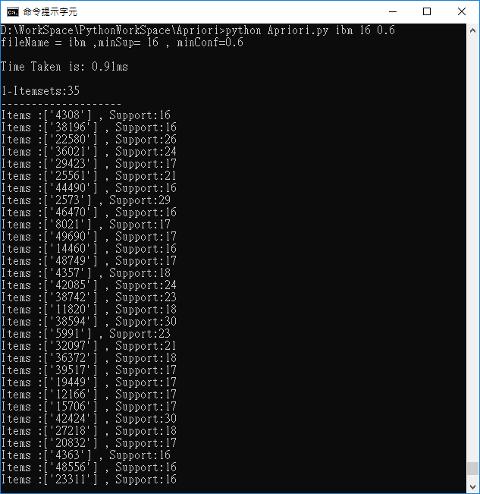
Apriori
python Apriori.py
dataSet = IBM
minSup= 16
minCon = 0.6
Take 0.91ms
1- ItemSets : 35

Slide 8
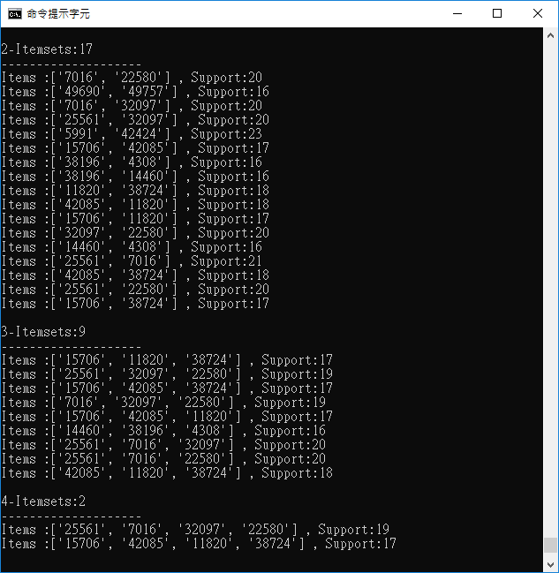
Apriori
python Apriori.py
dataSet = IBM
minSup= 16
minCon = 0.6
Take 0.91ms
2- ItemSets : 17
3- ItemSets : 9
4- ItemSets : 2

Slide 9
Apriori
Rule : ['38196'] -> ['4308'], confidence = 1.0
Rule : ['14460'] -> ['4308'], confidence = 1.0
Rule : ['38196', '14460'] -> ['4308'], confidence = 1.0
Rule : ['4308'] -> ['38196'], confidence = 1.0
Rule : ['14460'] -> ['38196'], confidence = 1.0
Rule : ['4308', '14460'] -> ['38196'], confidence = 1.0
Rule : ['7016'] -> ['22580'], confidence = 0.9523809523809523
Rule : ['32097'] -> ['22580'], confidence = 0.9523809523809523
Rule : ['25561'] -> ['22580'], confidence = 0.9523809523809523
Rule : ['25561', '32097'] -> ['22580'], confidence = 0.95
Rule : ['7016', '32097'] -> ['22580'], confidence = 0.95
Rule : ['25561', '7016'] -> ['22580'], confidence = 0.9523809523809523
Rule : ['25561', '7016', '32097'] -> ['22580'], confidence = 0.95
Rule : ['32097'] -> ['25561'], confidence = 0.9523809523809523
Rule : ['7016'] -> ['25561'], confidence = 1.0
Rule : ['22580'] -> ['25561'], confidence = 0.7692307692307693
Rule : ['32097', '22580'] -> ['25561'], confidence = 0.95
Rule : ['7016', '32097'] -> ['25561'], confidence = 1.0
Rule : ['7016', '22580'] -> ['25561'], confidence = 1.0
Rule : ['7016', '32097', '22580'] -> ['25561'], confidence = 1.0
Rule : ['49757'] -> ['49690'], confidence = 0.9411764705882353
Rule : ['38196'] -> ['14460'], confidence = 1.0
Rule : ['4308'] -> ['14460'], confidence = 1.0
Rule : ['38196', '4308'] -> ['14460'], confidence = 1.0
Rule : ['15706'] -> ['42085'], confidence = 1.0
Rule : ['11820'] -> ['42085'], confidence = 1.0
Rule : ['38724'] -> ['42085'], confidence = 1.0
Rule : ['15706', '38724'] -> ['42085'], confidence = 1.0
Rule : ['15706', '11820'] -> ['42085'], confidence = 1.0
Rule : ['11820', '38724'] -> ['42085'], confidence = 1.0
Rule : ['15706', '11820', '38724'] -> ['42085'], confidence = 1.0
Rule : ['38724'] -> ['11820'], confidence = 1.0
python Apriori.py
dataSet = IBM
minSup= 16
minCon = 0.6
Take 0.91ms

Slide 10
Apriori
Rule : ['42085'] -> ['11820'], confidence = 0.75
Rule : ['15706'] -> ['11820'], confidence = 1.0
Rule : ['15706', '38724'] -> ['11820'], confidence = 1.0
Rule : ['15706', '42085'] -> ['11820'], confidence = 1.0
Rule : ['42085', '38724'] -> ['11820'], confidence = 1.0
Rule : ['15706', '42085', '38724'] -> ['11820'], confidence = 1.0
Rule : ['42424'] -> ['5991'], confidence = 0.7666666666666667
Rule : ['7016'] -> ['32097'], confidence = 0.9523809523809523
Rule : ['25561'] -> ['32097'], confidence = 0.9523809523809523
Rule : ['22580'] -> ['32097'], confidence = 0.7692307692307693
Rule : ['25561', '22580'] -> ['32097'], confidence = 0.95
Rule : ['7016', '22580'] -> ['32097'], confidence = 0.95
Rule : ['25561', '7016'] -> ['32097'], confidence = 0.9523809523809523
Rule : ['25561', '7016', '22580'] -> ['32097'], confidence = 0.95
Rule : ['42085'] -> ['15706'], confidence = 0.7083333333333334
Rule : ['11820'] -> ['15706'], confidence = 0.9444444444444444
Rule : ['38724'] -> ['15706'], confidence = 0.9444444444444444
Rule : ['11820', '38724'] -> ['15706'], confidence = 0.9444444444444444
Rule : ['42085', '38724'] -> ['15706'], confidence = 0.9444444444444444
Rule : ['42085', '11820'] -> ['15706'], confidence = 0.9444444444444444
Rule : ['42085', '38724', '11820'] -> ['15706'], confidence = 0.9444444444444444
Rule : ['5991'] -> ['42424'], confidence = 1.0
Rule : ['22580'] -> ['7016'], confidence = 0.7692307692307693
Rule : ['32097'] -> ['7016'], confidence = 0.9523809523809523
Rule : ['25561'] -> ['7016'], confidence = 1.0
Rule : ['32097', '22580'] -> ['7016'], confidence = 0.95
Rule : ['25561', '32097'] -> ['7016'], confidence = 1.0
Rule : ['25561', '22580'] -> ['7016'], confidence = 1.0
Rule : ['25561', '32097', '22580'] -> ['7016'], confidence = 1.0
Rule : ['11820'] -> ['38724'], confidence = 1.0
Rule : ['42085'] -> ['38724'], confidence = 0.75
Rule : ['15706'] -> ['38724'], confidence = 1.0
Rule : ['15706', '11820'] -> ['38724'], confidence = 1.0
Rule : ['15706', '42085'] -> ['38724'], confidence = 1.0
Rule : ['42085', '11820'] -> ['38724'], confidence = 1.0
Rule : ['15706', '42085', '11820'] -> ['38724'], confidence = 1.0
Rule : ['49690'] -> ['49757'], confidence = 0.9411764705882353
python Apriori.py
dataSet = IBM
minSup= 16
minCon = 0.6
Take 0.91ms

Slide 11
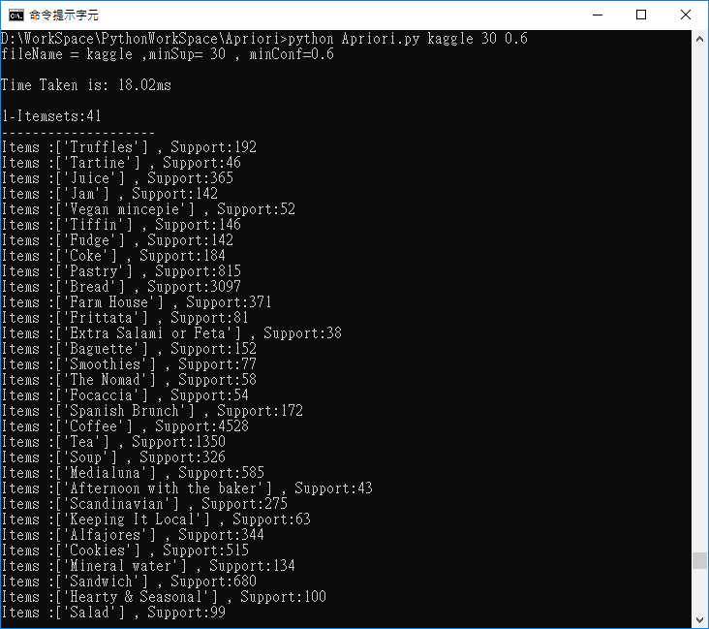
Apriori
python Apriori.py
dataSet = kaggle
minSup= 30
minCon = 0.6
Take 18.02ms
1- ItemSets : 41

Slide 12
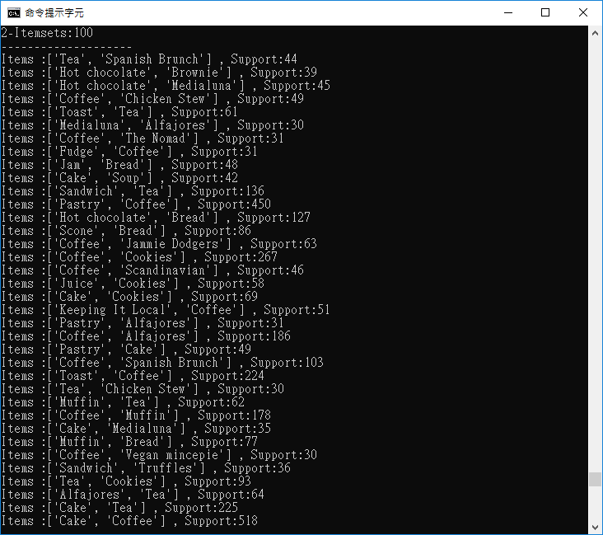
Apriori
python Apriori.py
dataSet = kaggle
minSup= 30
minCon = 0.6
Take 18.02ms
2- ItemSets : 100

Slide 13
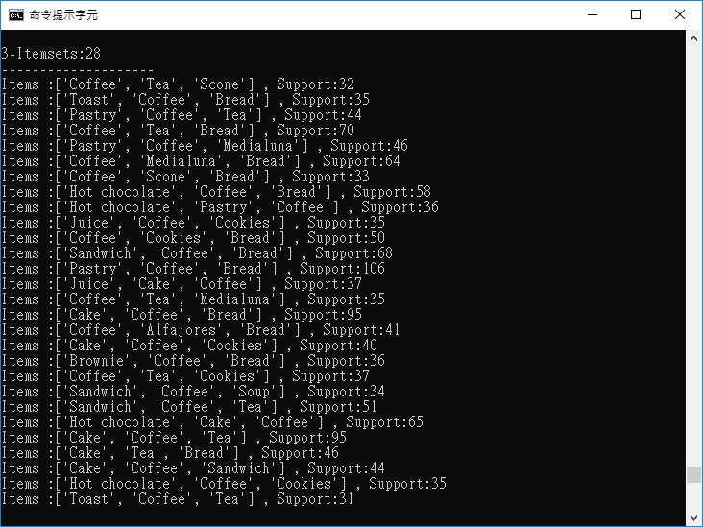
Apriori
python Apriori.py
dataSet = kaggle
minSup= 30
minCon = 0.6
Take 18.02ms
3- ItemSets : 28

Slide 14
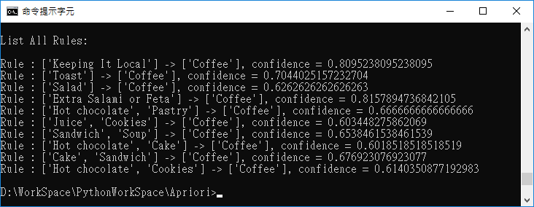
Apriori
python Apriori.py
dataSet = kaggle
minSup= 30
minCon = 0.6
Take 18.02ms
Rule : ['Keeping It Local'] -> ['Coffee'], confidence = 0.8095238095238095
Rule : ['Toast'] -> ['Coffee'], confidence = 0.7044025157232704
Rule : ['Salad'] -> ['Coffee'], confidence = 0.6262626262626263
Rule : ['Extra Salami or Feta'] -> ['Coffee'], confidence = 0.8157894736842105
Rule : ['Hot chocolate', 'Pastry'] -> ['Coffee'], confidence = 0.6666666666666666
Rule : ['Juice', 'Cookies'] -> ['Coffee'], confidence = 0.603448275862069
Rule : ['Sandwich', 'Soup'] -> ['Coffee'], confidence = 0.6538461538461539
Rule : ['Hot chocolate', 'Cake'] -> ['Coffee'], confidence = 0.6018518518518519
Rule : ['Cake', 'Sandwich'] -> ['Coffee'], confidence = 0.676923076923077
Rule : ['Hot chocolate', 'Cookies'] -> ['Coffee'], confidence = 0.6140350877192983

Slide 15
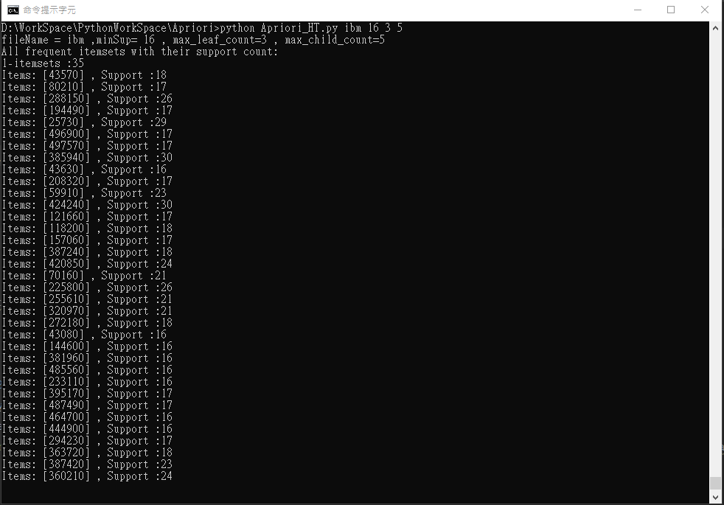
Apriori (Hash Tree)
python Apriori_HT.py
dataSet = IBM
minSup= 16
Take 0.008ms
max_leaf_count=3
max_child_count=5
1- ItemSets : 35

Slide 16
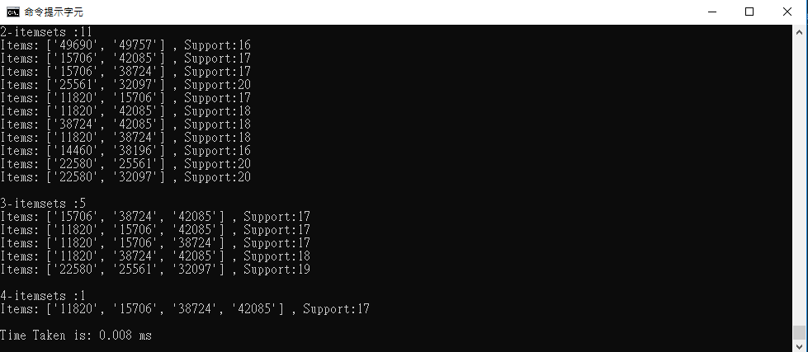
Apriori (Hash Tree)
python Apriori_HT.py
dataSet = IBM
minSup= 16
Take 0.008ms
max_leaf_count=3
max_child_count=5
2- ItemSets : 11
3- ItemSets : 5
4- ItemSets : 1

Slide 17
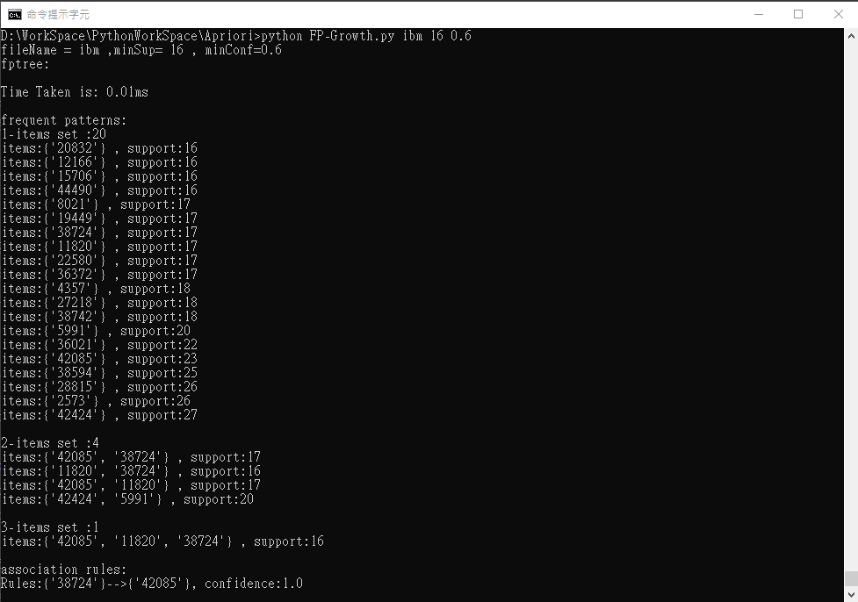
FP-Growth
python FP-Growth.py
DataSet = IBM
minSup = 16
minCon = 0.6
Take 0.01ms
1- ItemSets : 20
2- ItemSets : 4
3- ItemSets : 1

Slide 18
FP-Growth
association rules:
Rules:{'38724'}-->{'42085'}, confidence:1.0
Rules:{'42085'}-->{'38724'}, confidence:0.7391304347826086
Rules:{'38724'}-->{'11820'}, confidence:0.9411764705882353
Rules:{'11820'}-->{'38724'}, confidence:0.9411764705882353
Rules:{'11820', '38724'}-->{'42085'}, confidence:1.0
Rules:{'38724'}-->{'42085', '11820'}, confidence:0.9411764705882353
Rules:{'11820'}-->{'42085', '38724'}, confidence:0.9411764705882353
Rules:{'42085', '38724'}-->{'11820'}, confidence:0.9411764705882353
Rules:{'42085'}-->{'11820', '38724'}, confidence:0.6956521739130435
Rules:{'42085', '11820'}-->{'38724'}, confidence:0.9411764705882353
Rules:{'11820'}-->{'42085'}, confidence:1.0
Rules:{'42085'}-->{'11820'}, confidence:0.7391304347826086
Rules:{'5991'}-->{'42424'}, confidence:1.0
Rules:{'42424'}-->{'5991'}, confidence:0.7407407407407407
python FP-Growth.py
DataSet = IBM
minSup = 16
minCon = 0.6
Take 0.01ms

Slide 19
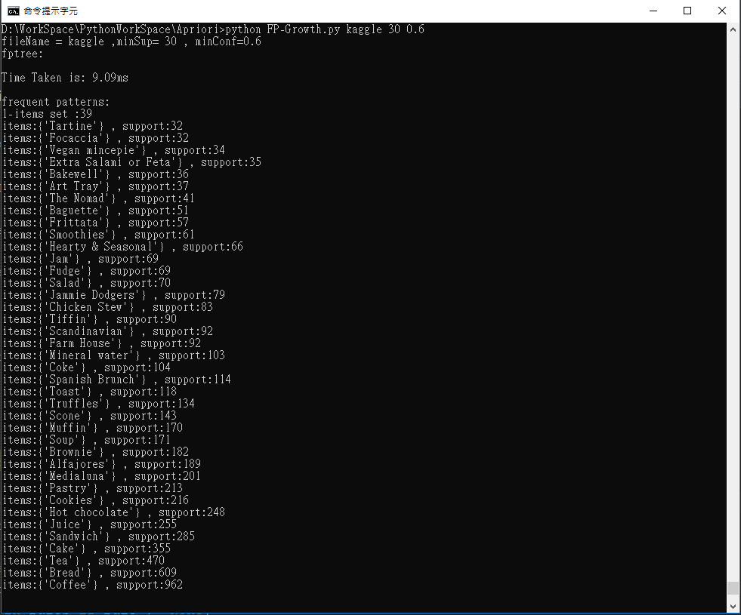
FP-Growth
python FP-Growth.py
DataSet = kaggle
minSup = 30
minCon = 0.6
Take 9.09ms
1- ItemSets : 39

Slide 20
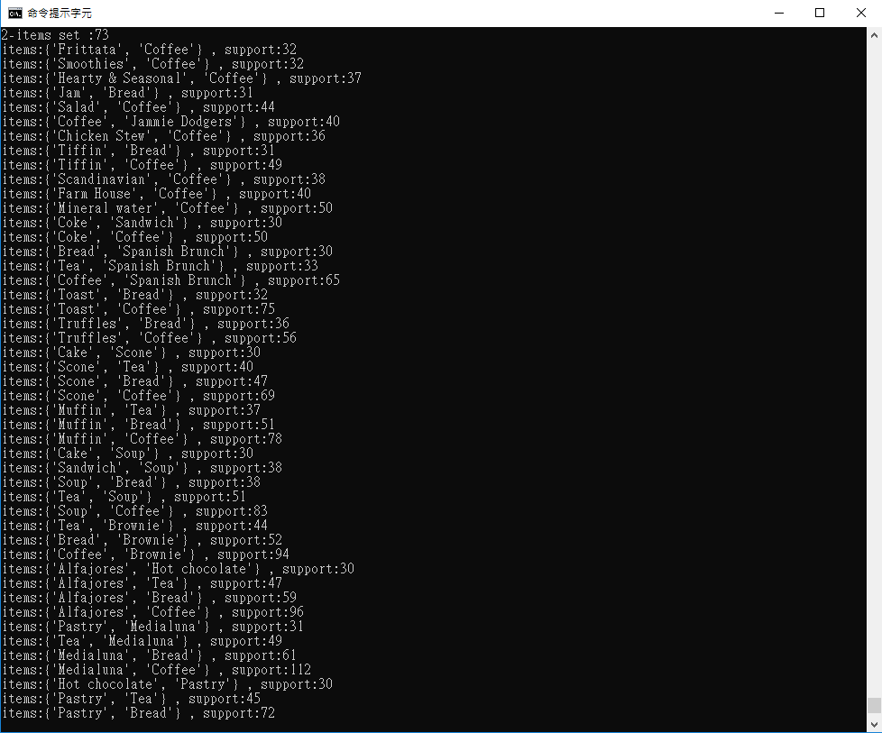
FP-Growth
python FP-Growth.py
DataSet = kaggle
minSup = 30
minCon = 0.6
Take 9.09ms
2- ItemSets : 73

Slide 21
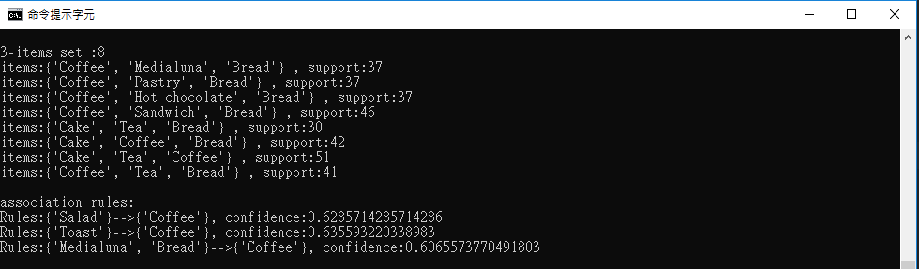
FP-Growth
python FP-Growth.py
DataSet = kaggle
minSup = 30
minCon = 0.6
Take 9.09ms
3- ItemSets : 8
association rules:
Rules:{'Salad'}-->{'Coffee'}, confidence:0.6285714285714286
Rules:{'Toast'}-->{'Coffee'}, confidence:0.635593220338983
Rules:{'Medialuna', 'Bread'}-->{'Coffee'}, confidence:0.6065573770491803

Slide 22
Conclusion & observation
以IBM的Data為目標分析三個演算法的運算時間
我們可以清楚發現到傳統Apriori演算法的運算速度，相較於其他兩者是最慢的
而Hash-Tree的方式讓人很意外的是居然速度比FP-Growth還要更快
而在IBM資料集上，FP-Growth比起Apriori快上了90倍
但是在Kaggle資料集上，FP-Growth比起Apriori只快上2倍
在根據前面資料集的itemset數量來看，kaggle的itemset整整是IBM的10倍
因此可以推斷在越大的資料中使用FP-Growth效能改善可能不是那麼的明顯
 | Apriori | Hash-Tree | FP-Growth
IBM | 0.91(ms) | 0.008(ms) | 0.01(ms)
Kaggle | 18.02(ms) | X | 9.09(ms)

Slide 23
memory usage
使用Ipython的%memit剖析並比較佔用的記憶體
很明顯的可以發現Hash-Tree所佔用的記憶體最多，與前一張表對比可以發現
Hash-Tree算是一個以空間換取時間效能的策略，而Apriori所佔的記憶體最少
 | Apriori | Hash-Tree | FP-Growth
IBM | 87.67 MiB increment: 0.00 MiB | 89.51 MiB increment: 0.05 MiB | 89.15 MiB increment: 0.06 MiB
Kaggle | 87.50 MiB increment: 0.14 MiB | X | 89.09 MiB increment: 0.06 MiB

Slide 24
Conclusion & observation
以IBM的Data為目標分析三個演算法的結果
[Freq-itemSet1 ,…, Freq-itemSetN]
我們可以清楚發現在Kaggle資料集中，不管在哪一種演算法下freq-itemset2始終是所有freq-itemset中數量最多的，也許是因為資料集的數目夠大而且互相牽引的關係夠多，產生眾多的freq-itemset2
 | Apriori | Hash-Tree | FP-Growth
IBM | [35,17,9,2] | [35,11,5,1] | [20,4,1]
Kaggle | [41,100,28] | X | [39,73,8]

Slide 25
Conclusion & observation
另外我們發現到以Hash-Tree 實作Apriori的算法，它的max_leaf_count與max_child_count似乎不太會去影響它的最終結果
以IBM的Data為目標分析max_leaf_count的影響
以IBM的Data為目標分析max_child_count的影響
 | max_leaf_count = 3 | max_leaf_count = 10 | max_leaf_count = 20
Hash-Tree | [35,11,5,1] | [35,11,5,1] | [35,11,5,1]
 | max_child_count = 5 | max_child_count = 10 | max_child_count = 20
Hash-Tree | [35,11,5,1] | [35,11,5,1] | [35,11,5,1]

